Slide 1



INDIVIDUAL PROJECT 1
Swimming Pool App
Presented by: Nur Izzati Bt Abdul Manaf
01

Slide 2
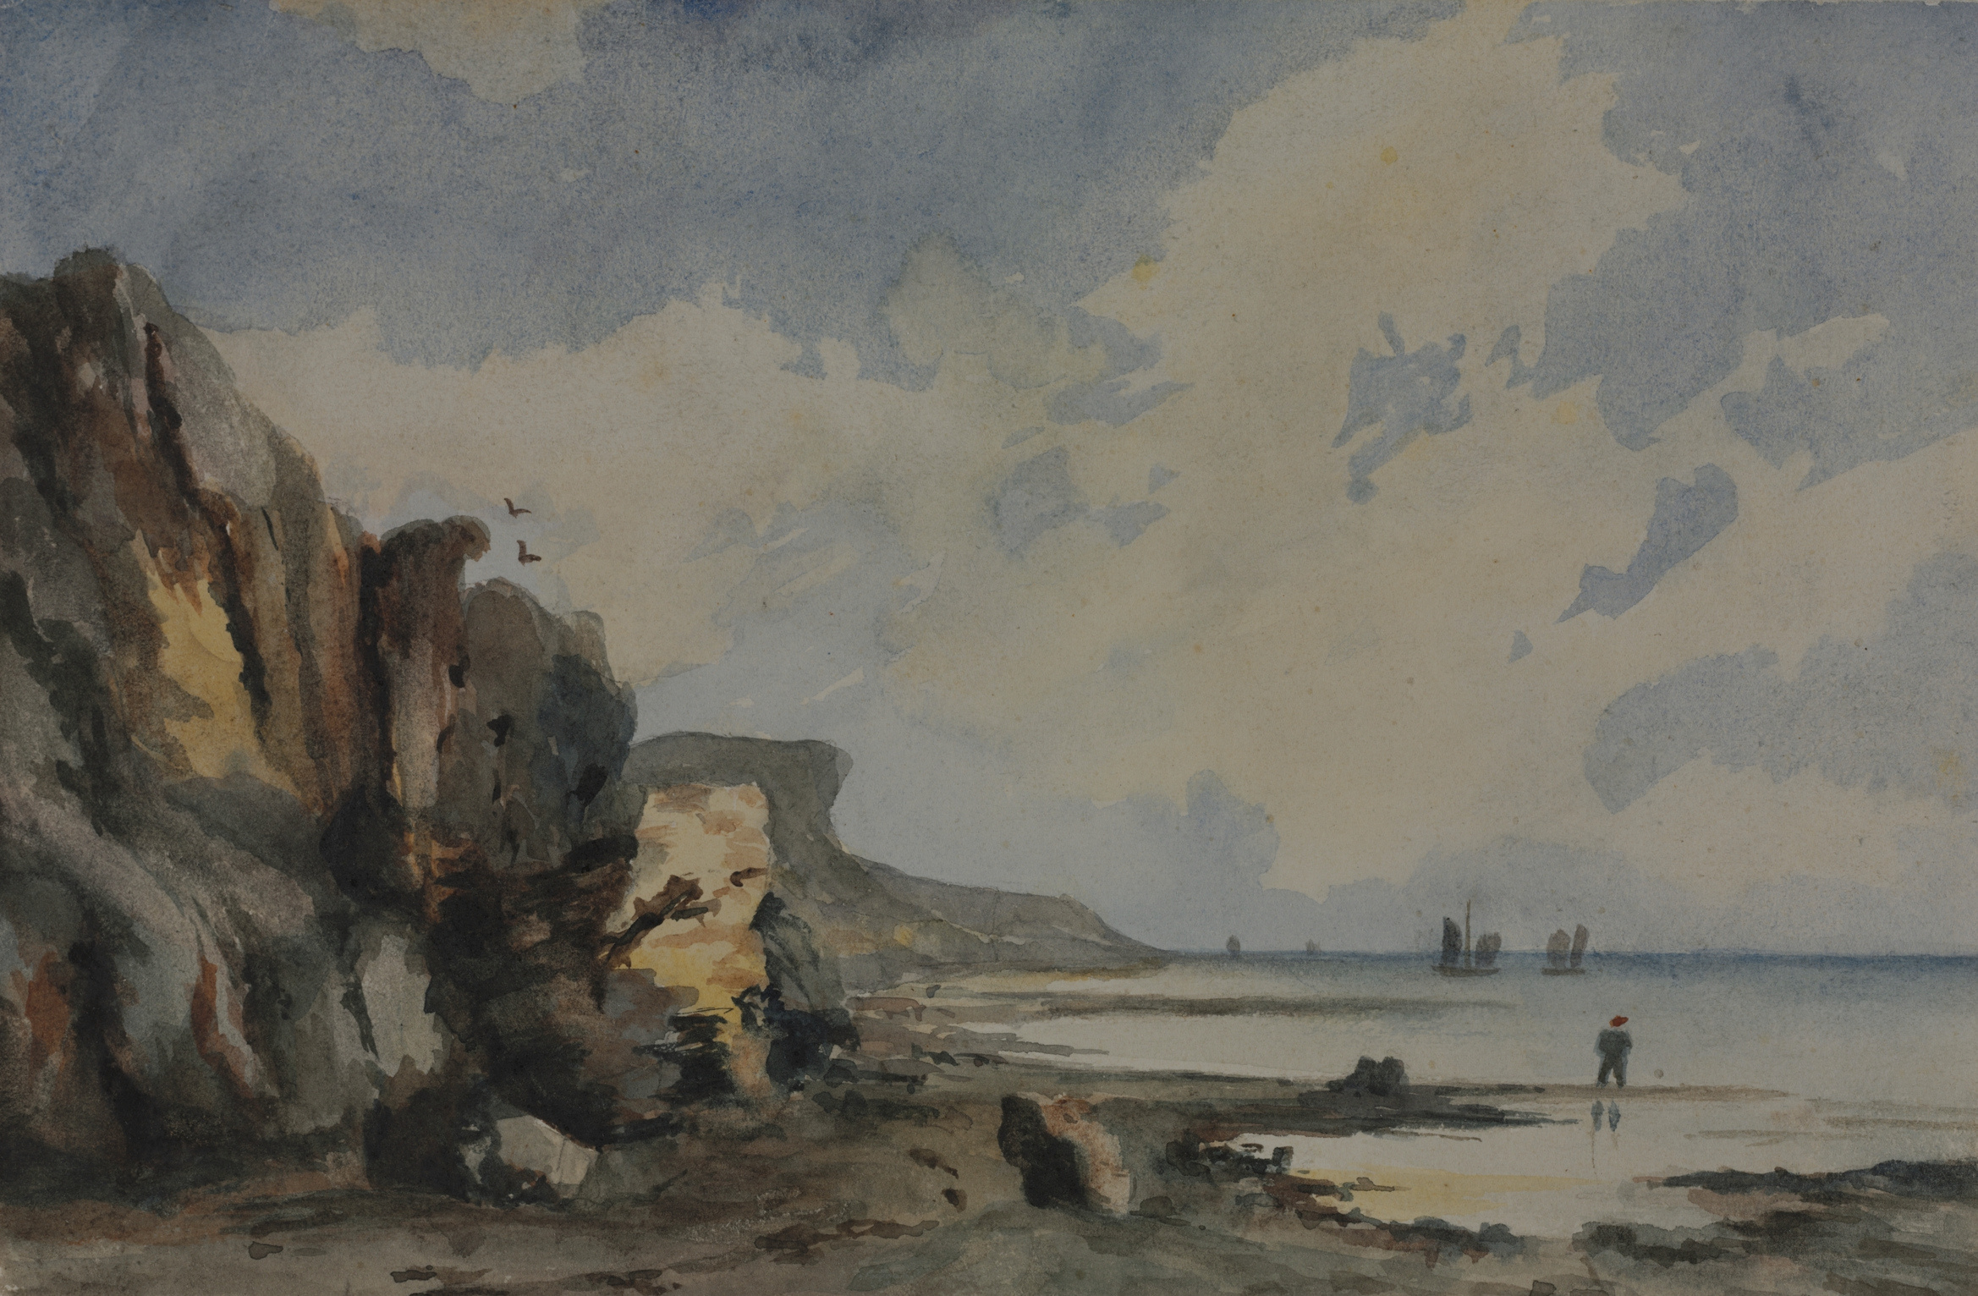
INDIVIDUAL PROJECT 1
A
Summary Layout
B
Prototype Design
Presentation Overview
C
UI with Demo
D
Potential Commercial Value
E
Pricing of the Prototype
F
Conclusion
G
Reference
02

Slide 3
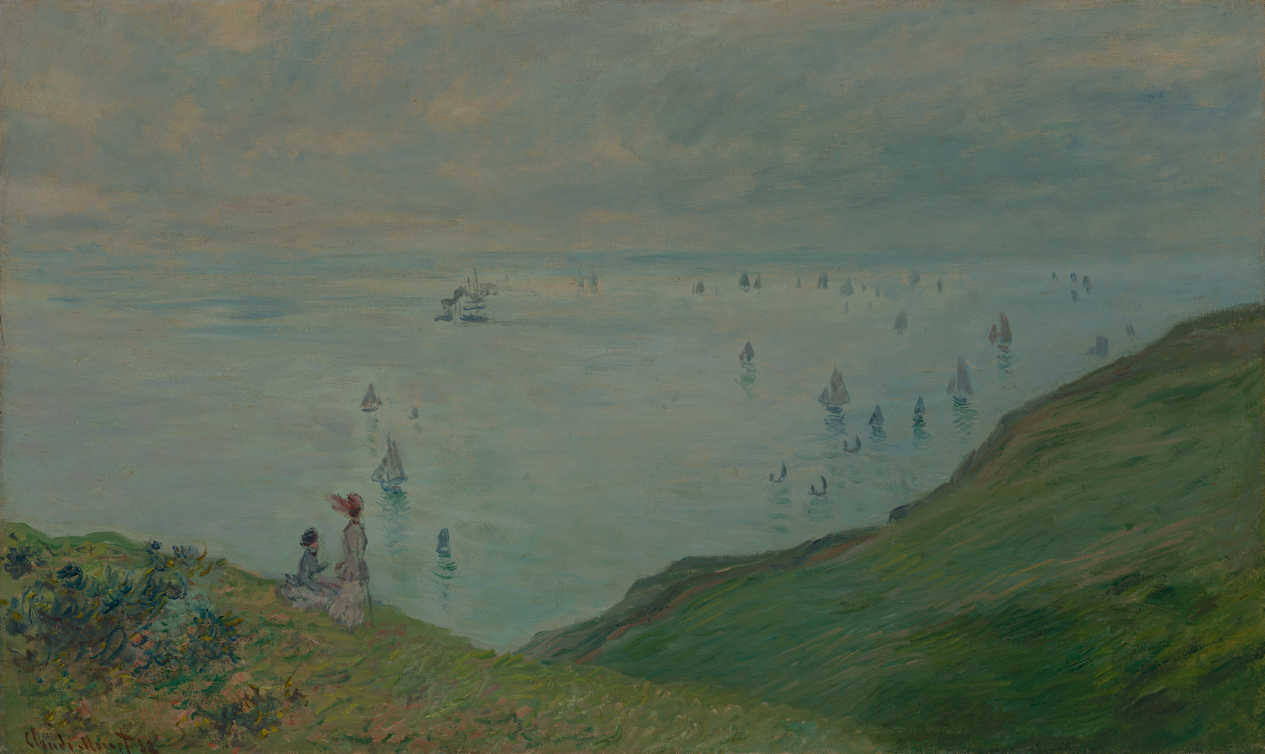
INDIVIDUAL PROJECT 1
Executive of Summary layout
The UMT Swimming Pool Booking App represents a significant advancement in optimizing the utilizing of our university’s facilities. This app is developed to enhance accessibility and personalization for our UMT community members
With a user-friendly interface, the app simplifies the process of scheduling swimming sessions. At the core of its functionality are three features that enhance user experience: date selection, time preferences, and booking confirmation reviews.
04

Slide 4
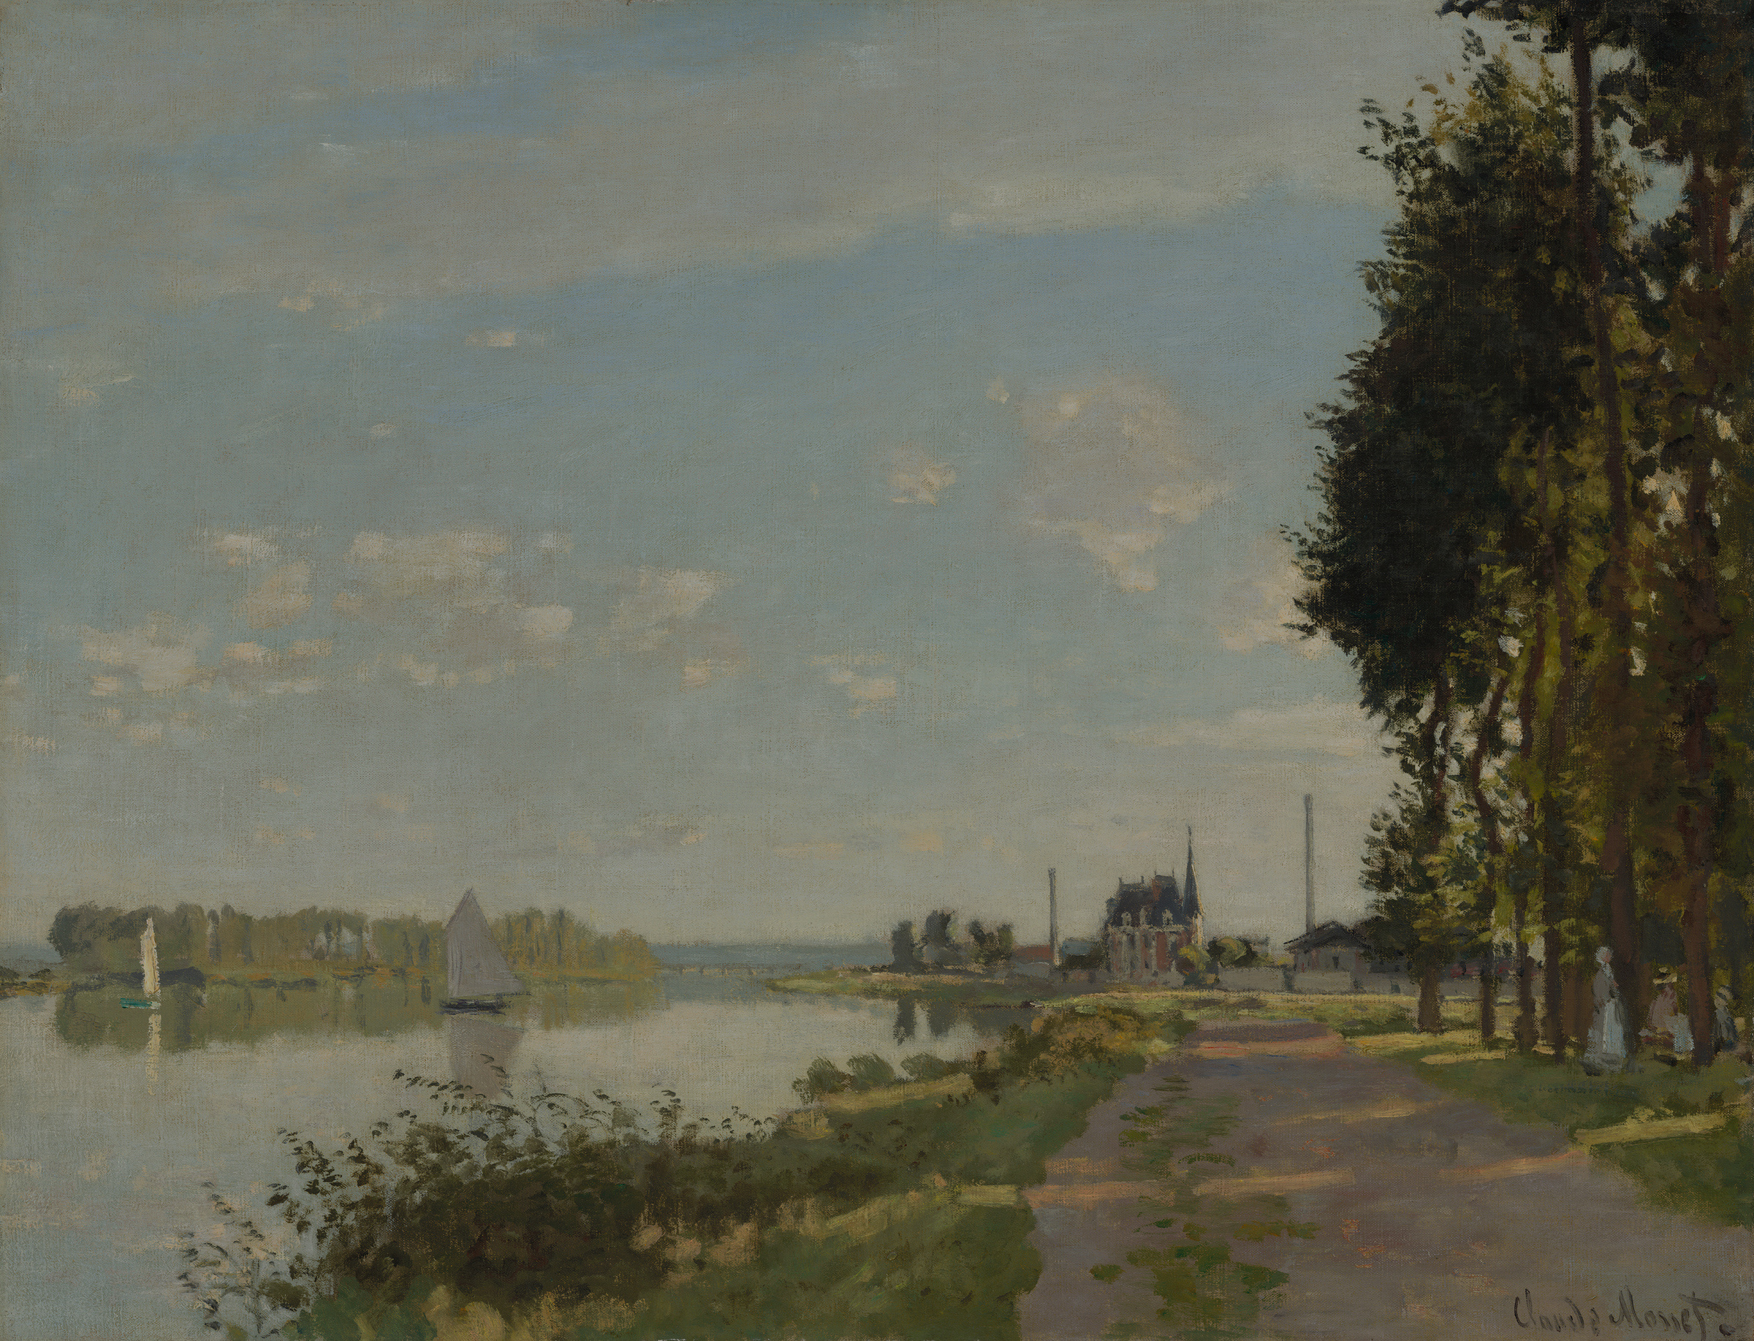
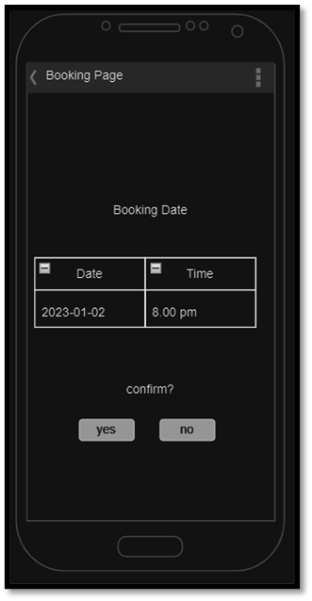
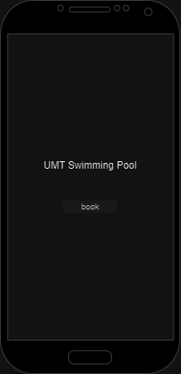
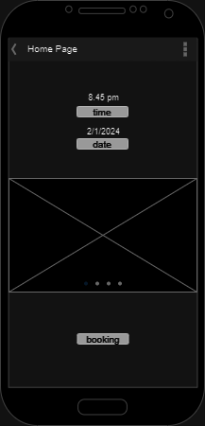
INDIVIDUAL PROJECT 1
Prototype Design
04

Slide 5

INDIVIDUAL PROJECT 1
About me
Eleanor Fitzgerald
Demo With Explanation
PROFESSIONAL PAINTER
Personalize your presentation by customizing this slide as much as you want. Then, ask questions to interact with your audience.
03

Slide 6
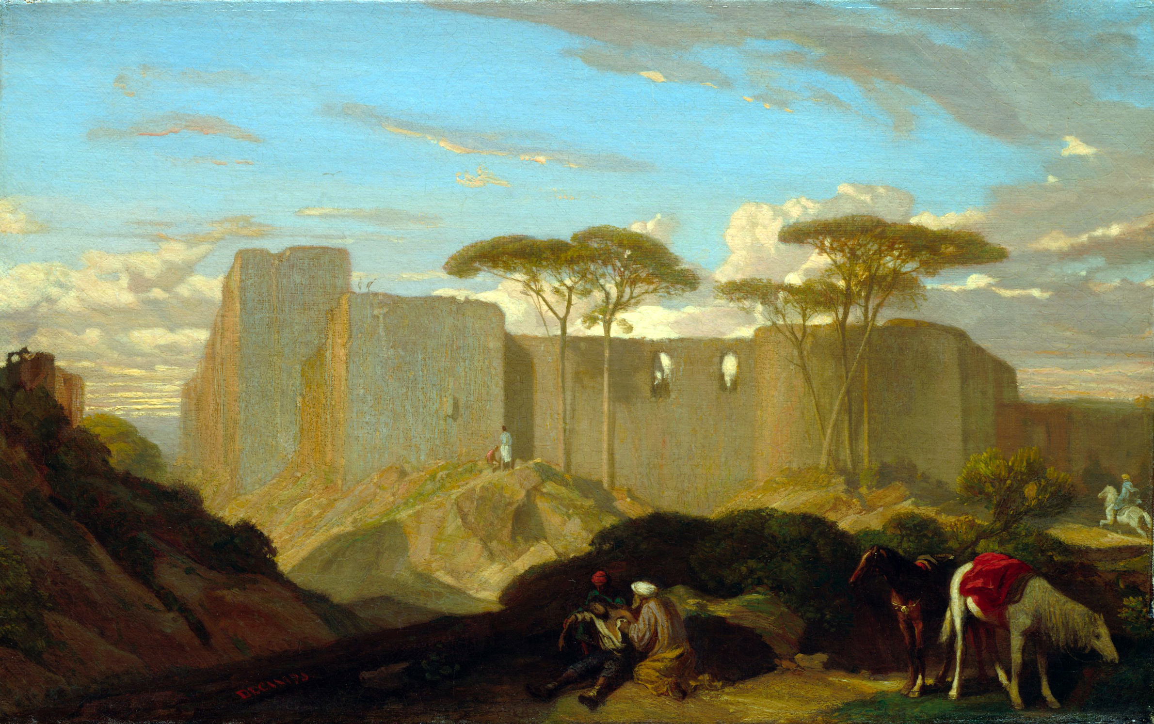
INDIVIDUAL PROJECT 1
23 JANUARY
Potential Commercial Value
Prototype Pricing
This project mainly focused on UMT student with approximately 10,000 students. With the existence of this apps, surely it will make the process of booking swimming pool much more easier.
This apps holds promising commercial value by offering opportunities for revenue generation through subscription models. This apps streamlining the reservation process, offering a user-friendly interface, and providing real-time availability updates, the app serves the needs of both individuals and businesses
Approximately, this project targeting to set price for RM0.99 per month
For early subscription, we extend the exclusive benefit of enjoying the first three months at no cost.
05

Slide 7
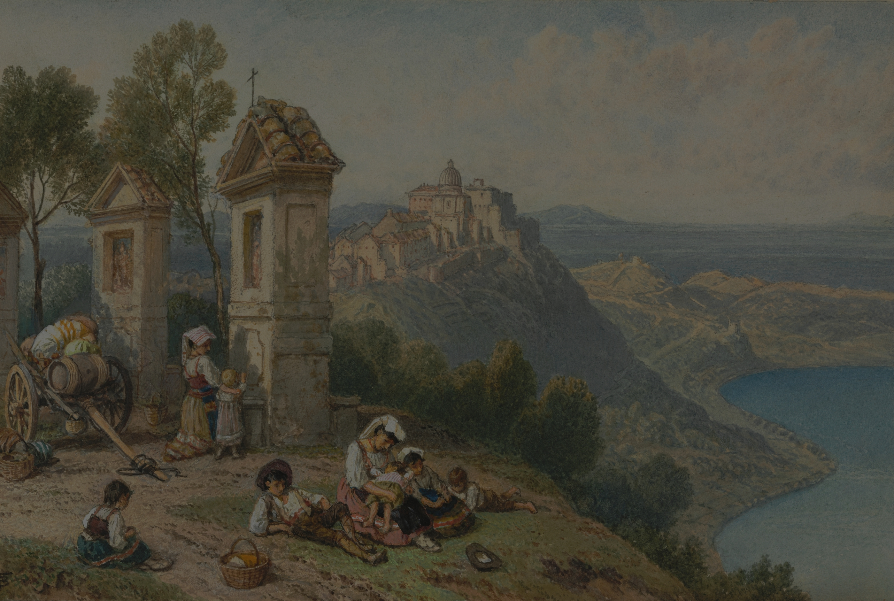
INDIVIDUAL PROJECT 1
Conclusion
In conclusion, the UMT Swimming Pool Booking Application stands as a transformative solution, not only increasing user convenience in scheduling swimming sessions but also presenting a robust and diverse commercial model. This project not only signifies a commitment to user satisfaction but also opens doors for potential expansions and continuous improvement.
07

Slide 8
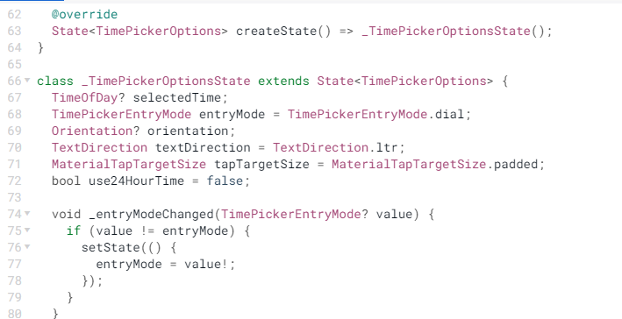
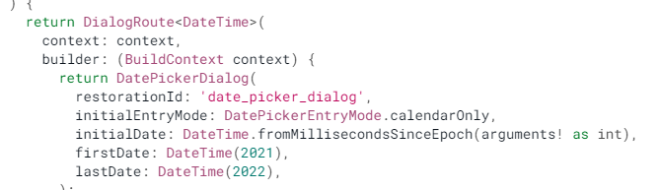
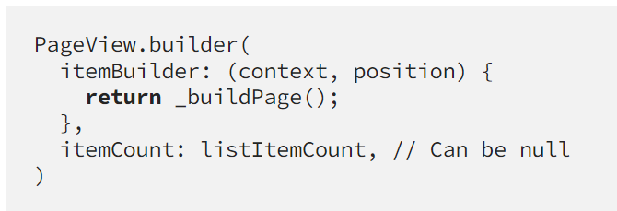
INDIVIDUSL PROJECT 1
Reference
time picker
date picker
slideshow
08

Slide 9
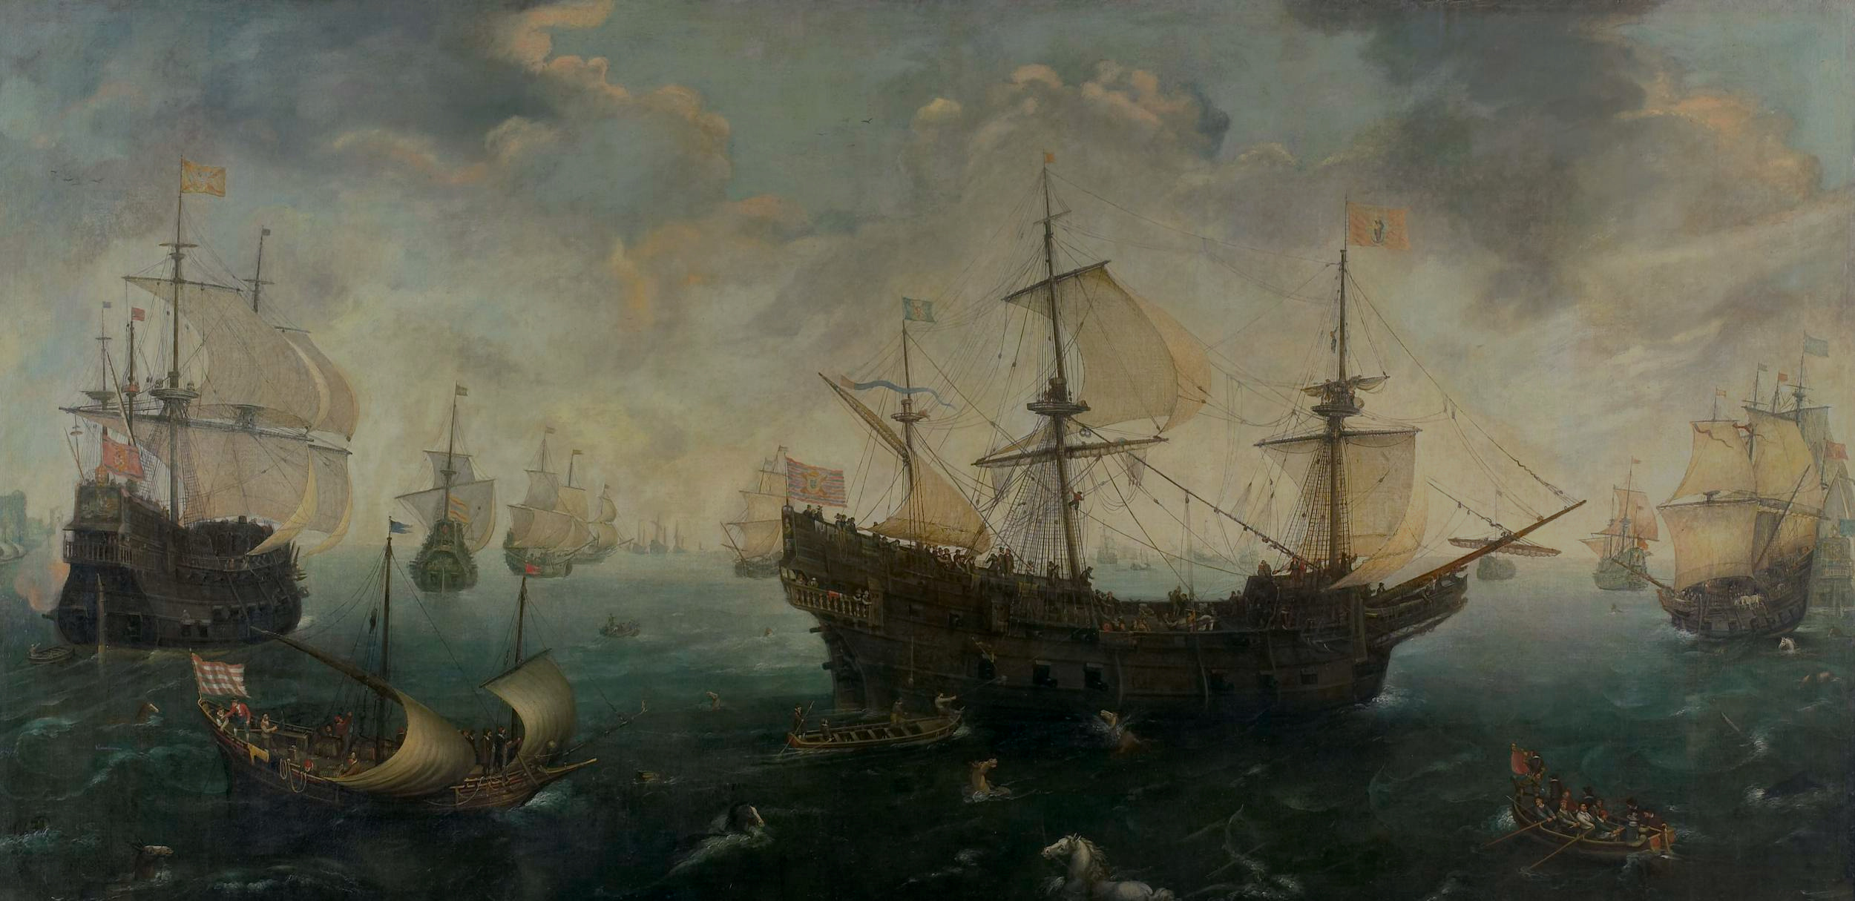
INDIVIDUAL PROJECT 1
Thank you for listening!
11

